Slide 1

Applied Data Science Capstone
The Battle of Neighborhoods

Slide 2
Introduction
The objective of this project is to help Department of Health and Mental Hygiene explore neighborhoods with the worst restaurants. It will help make a smart and efficient decision to choose to inspect restaurants in Brooklyn neighborhoods.

Slide 3
Problem Which Tried to Solve
The problem tried to solve is that of facilitating the targeted planning of inspections by the Department of Health and Mental Hygiene

Slide 4
DATA
DATA 1 :
Source: http://www1.nyc.gov/site/doh/services/restaurant-grades.page
description : contains the findings of registrations by the Department of Health and Mental Hygiene of during inspections in restaurants
DATA 2 :
Source: https://geo.nyu.edu/catalog/nyu_2451_34572
description : contains all the geographic coordinates of all New York neighborhoods

Slide 5
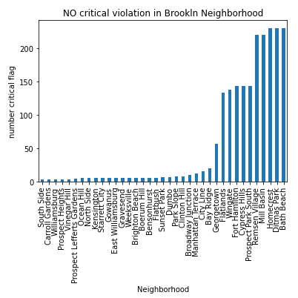
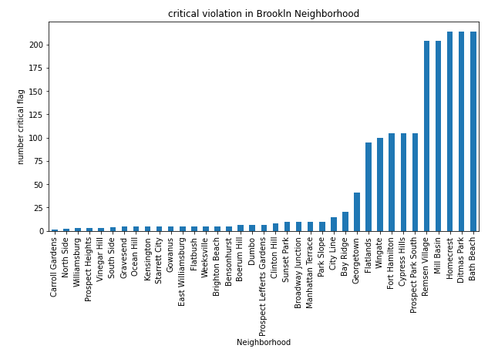
VIOLATION IN BROOKLN

Slide 6

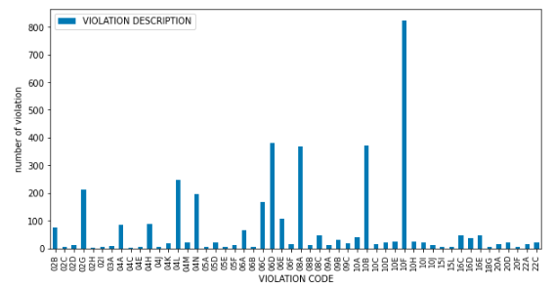
Frequency of violations

Slide 7
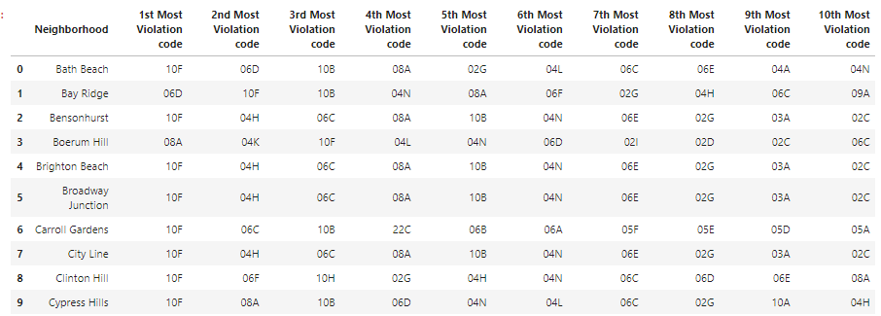
The 10 most common violations by neighborhood

Slide 8
Cluster of Neighborhoods
We have common violation code categories in neighborhoods. For this reason, I used an unsupervised K-means learning algorithm to group neighborhoods. The K-Means algorithm is one of the most common cluster methods of unsupervised learning.

Slide 9
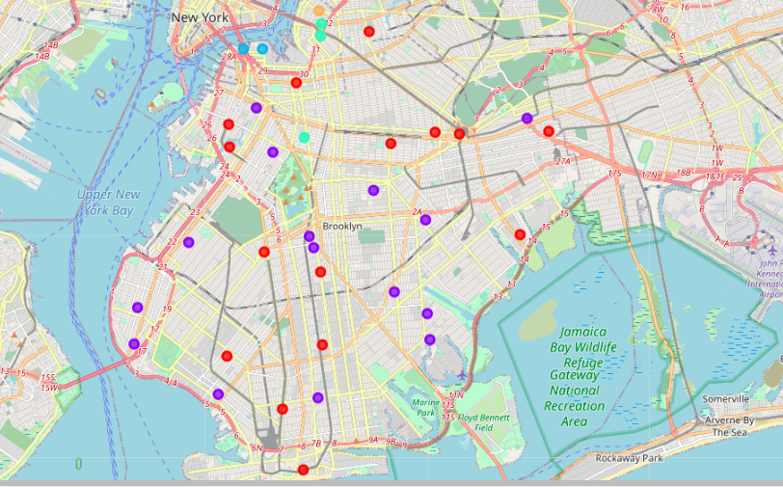
Map of Neighborhood Cluster

Slide 10
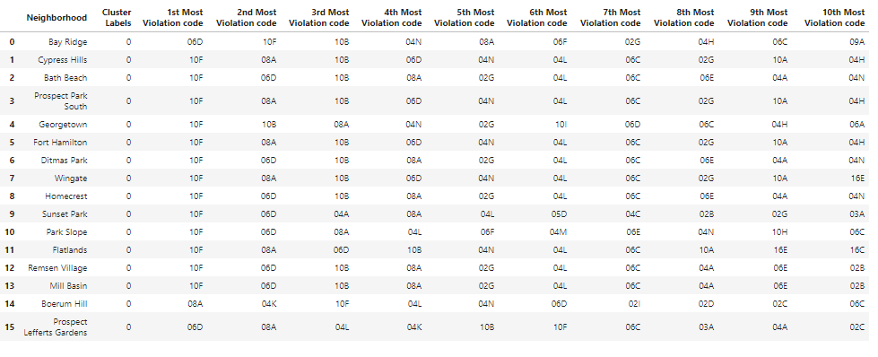
Presentation of Cluster
Cluster 1

Slide 11
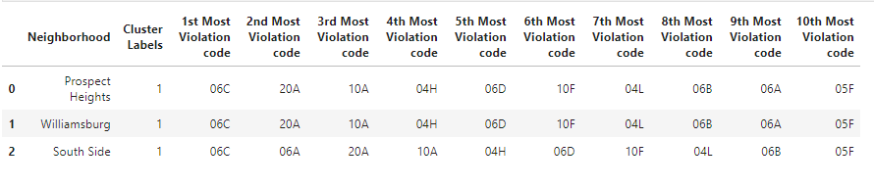
Presentation of Cluster
Cluster 2
This cluster contains the neighborhoods with the least critical violation

Slide 12
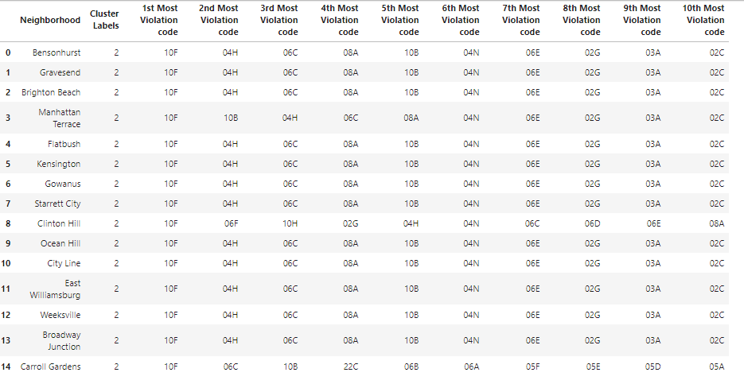
Presentation of Cluster
Cluster 3

Slide 13
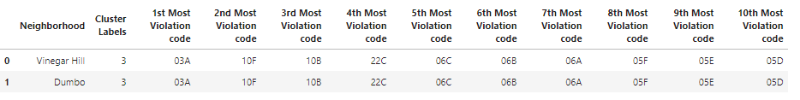

Presentation of Cluster
Cluster 4
Cluster 5

Slide 14
Discussion
Bath Beach is where we find the most critical violation in restaurants. Cluster 1 cuts across neighborhoods similar to Bath Beach. It is therefore recommended that the Department of Health and Mental Hygiene increase inspections in these areas.
we also note that the most common violation are as follows: Non-food contact surface improperly constructed. Unacceptable material used. Non-food contact surface or equipment improperly maintained and/or not properly sealed, raised, spaced or movable to allow accessibility for cleaning on all sides, above and underneath the unit.

Slide 15
Library used
Pandas: For creating and manipulating dataframes.
Folium: Python visualization library would be used to visualize the neighborhoods cluster distribution of using interactive leaflet map.
Scikit Learn: For importing k-means clustering.
JSON: Library to handle JSON files.
XML: To separate data from presentation and XML stores data in plain text format.
Geocoder: To retrieve Location Data.
Beautiful Soup and Requests: To scrap and library to handle http requests.
Matplotlib: Python Plotting Module.

Slide 16
Conclusion
The department carries out regular inspections. To optimize and specialized it is inspection, it is therefore important to resort to analysis techniques.
Our analysis therefore proposed the possibility of inspection optimization.
In the future we will improve this analysis so that it covers the whole of New York city

